Slide 1
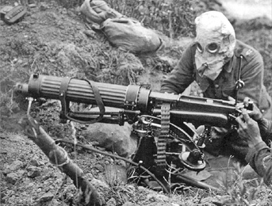
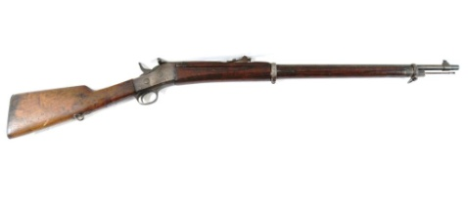
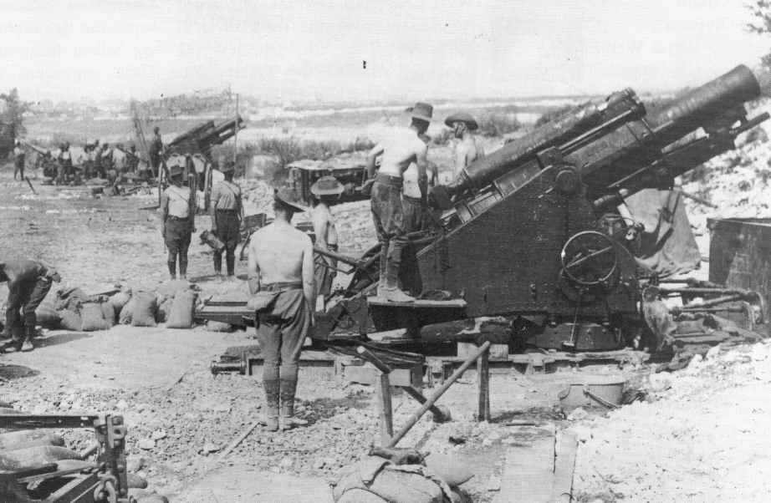
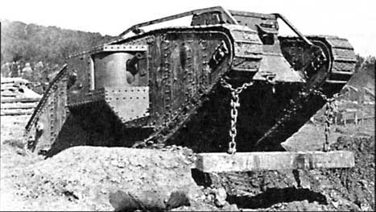
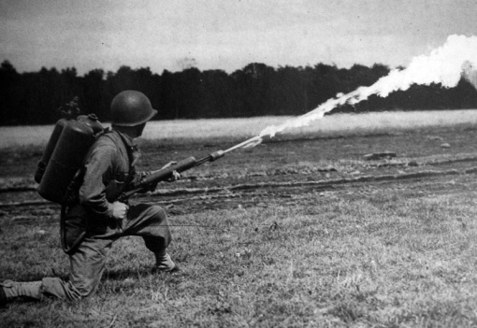
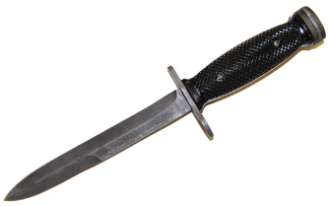
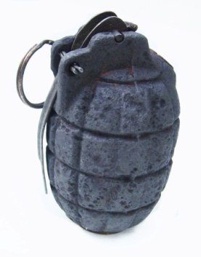
The Rifle:
The rifle was the standard weapon given to all soldiers during the Great War. It was lightweight so it could be easily carried and was deadly accurate up to 600m. Bullets were stored in a compartment under the rifle and the soldiers had to reload the rifle between shots. Highly trained soldiers could fire up to 15 shots a minute.
Machine-gun:
The machine gun dominated the battlefields of the Great War. A machine gun could fire up to 600 bullets a minute and attacking soldiers were mowed down. Although they were heavy and needed a crew of 5-6 men to carry it, it was worth around 100 rifles. It claimed millions of lives.
Artillery:
Artillery is the name given to guns that fire large bullets, or shells, over long distances. They were used a lot in the Great War and the enemy trenches were pounded with artillery for days before an attack. It was the constant firing of these guns that turned the landscape into mud baths. The guns got bigger and more powerful as the war went on.
Poison Gas:
In an attempt to get past the deadly machine guns, both sides tried to use poisonous gas. The French first used tear gas at the beginning of the war but it was the Germans who made the deadly chlorine gas. When it was breathed in, it attacked the lungs and caused coughing fits. Britain and France quickly launched revenge gas attacks with deadlier poisons like mustard gas. Unfortunately if the wind changed direction, it could do more harm than good. Troops became wise to the gas attacks and gas masks were used to protect the troops.
Tank:
This was another way of trying to get past the machine guns and this time it was a British invention. Tanks were bullet proof machines that could travel over rough terrain, crush barbed wire and crush trenches. They were called ‘landships’ but were code named ‘tanks’ in order to trick the Germans and the name just stuck! Although they caused terror on the battlefield they were slow (4mph) and unreliable.
Flame thrower:
A canister of oil was strapped to a soldier’s back and forced through a nozzle to ‘fire’ at enemy soldiers. The oil was ignited by a spark to create a sheet of flame that could travel up to 15 metres. Hand-held flame-throwers were deadly in small spaces, like dugouts, and caused panic if one was spotted during an attack. Any soldier carrying a flame thrower became an instant target for enemy firing. If the canister was hit, the soldier would disappear into a ball of flame.
Hand grenade:
It was the German’s who first realised how useful hand held bombs would be in the trenches. Soon all sides were using them to clear out enemy trenches. Bombing parties would sneak across no-mans land with bags of grenades and hurl them into dugouts. The grenades exploded and the case would shatter into tiny pieces. These would cause horrific injuries if any soldier was standing near by.
Bayonet:
Bayonets were long knives attached to the end of rifles. They were used to stab enemy soldiers in fierce hand to hand combat. They were a useful last resort when the ammunition run out.

