Slide 1
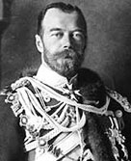
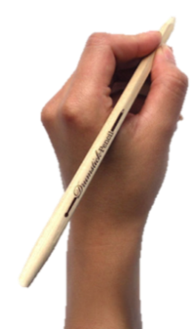
TITLE: How did the arms race help cause WWI?
Starter
Tsar Nicholas II of Russia
View photos of Tsar Nicolas
Send Tsar Nicolas a Message
Poke Tsar Nicolas
Basic info
Gender: MALE
Hometown: RUSSIA
Bio
What does Russia think in 1914?
Complete at least two sections of Tsar Nicholas’ Facebook profile, remembering what we learnt last lesson
?
?
?
Name
Name
Name
Activities
What has Russia been up to recently?
Notes:
Students can just use subheadings in books to identify what part of the profile they are completing

Slide 2
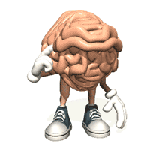
TITLE: How did the arms race help cause WWI?
Learning Objectives
Remember you should have written the title and date and underlined them both in your book by now!
4
All: must be able to state what is meant by an ‘arms race’
5
Most: should explain how the ‘arms race’ led to tensions in Europe
6
Some: could evaluate the implications of the arms race and Germany’ desire for an empire (imperialism) on the outbreak of WWI

Slide 3
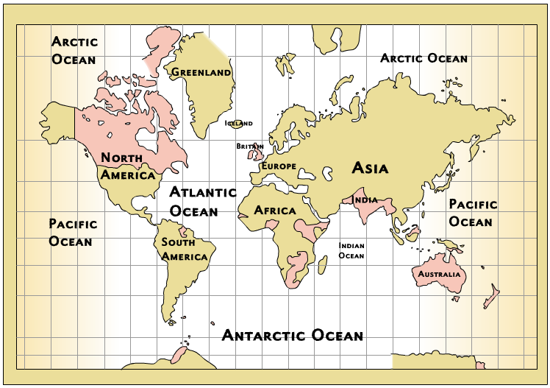
As you know, in 1900, Britain had a huge empire.

Slide 4
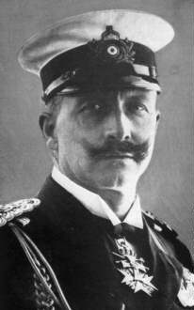
Germany feels left out…
By 1914, Britain had the biggest empire in history, giving it vast wealth and global power.
Germany wanted an empire too, but with much of the world already claimed and the ongoing scramble for Africa, Germany would have to fight to get one.
The German Kaiser, Wilhelm II, also wanted Germany to become a powerful force in world politics, able to influence and command other countries as Britain and France did.
If Germany were to fulfil its imperial and global ambitions, it would need to develop a strong military.
How might this lead to world conflict?

Slide 5
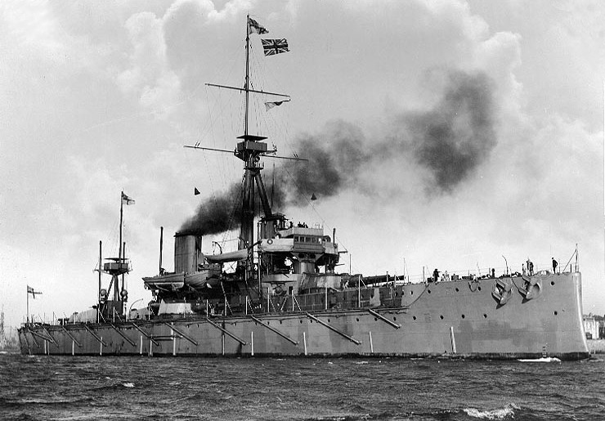
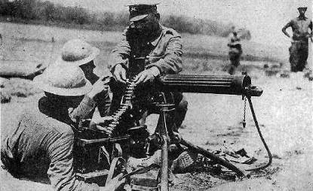
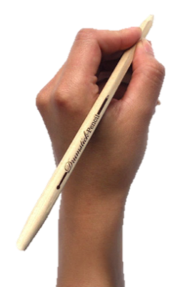
Key Term
An arms race is when two nations (or groups of nations) compete to develop the best military technology or the largest armed forces.
The ‘race’ is driven by fear that the other country will establish military superiority, and therefore become dominant.

Slide 6
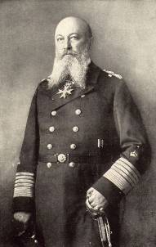
Arms Race
Kaiser Wilhelm II of Germany wanted Germany to have an empire of her own. He was closely related to the British royal family and admired Britain’s empire and powerful navy.
It was felt that in order to compete, Germany needed to develop its navy.
In my view, Germany will, in the coming century, rapidly drop from her position as a great power unless we begin to develop our maritime interests energetically, systematically and without delay.
^{Admiral Tirpitz, 1895}
Which country do you think would feel most threatened if Germany built up its navy?

Slide 7
Arms Race
For a long time, Great Britain had ruled the waves.
Britain had spent a great deal of time and money building a strong navy to protect its trade routes and overseas empire. Britain did not want other nations rivalling its dominance at sea.
In 1906, the Royal Navy launched HMS Dreadnought. It was a new style of battleship that was faster and more heavily armoured than any previous warship.
The Dreadnought worried the Germans and fuelled the developing arms race between Germany and Britain.
Germany decided that it too needed to build Dreadnoughts= naval arms race!

Slide 8
Notes:
http://www.bbc.co.uk/learningzone/clips/four-main-causes-of-the-first-world-war/5646.html

Slide 9
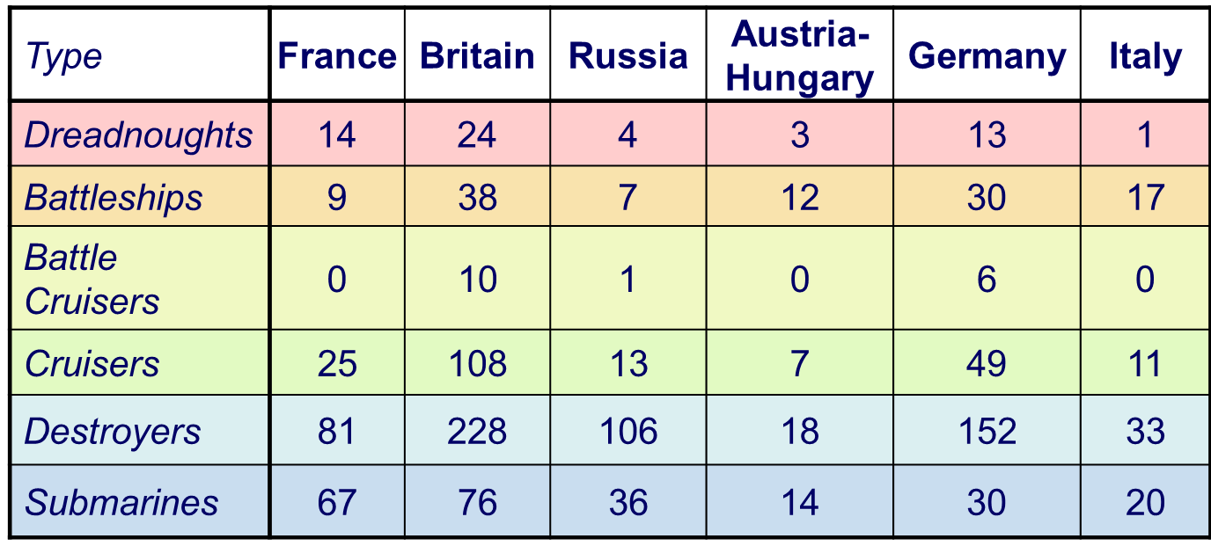
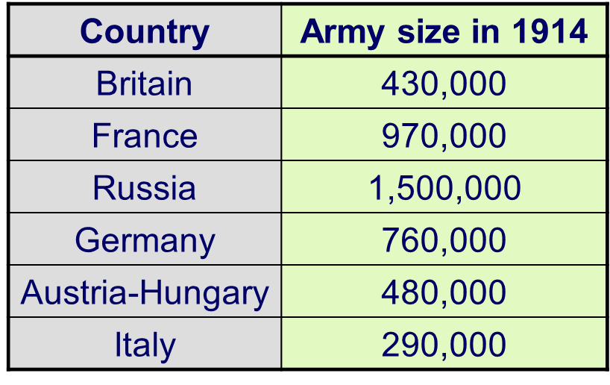
TASK: Arms Race
Who won the naval arms race?
Which of the two great alliances had the best chance of winning a war at sea?
On paper, which alliance had more soldiers?
Do you think this was an important factor in the outbreak of war? Why?
Notes:
Could print this slide

Slide 10
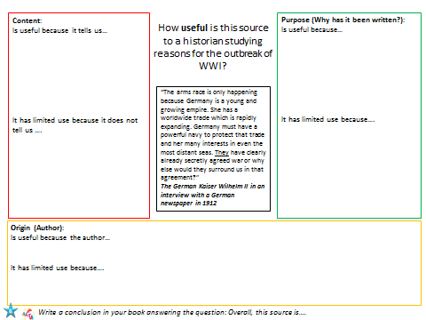
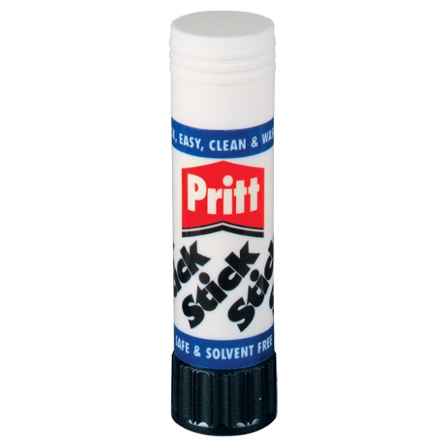
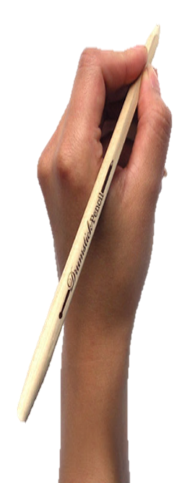
TASK: Usefulness?
How useful is this source to a historian studying the reasons for the outbreak of WWI?
Use the sheet provided to fully work out the usefulness of this source.
Write a conclusion: Overall, this source is….
Notes:
Differentiated sheets provided- Students have been practising this style of question since their assessment. This will be the 3rd they have completed. Ability to analyse sources still needs to be developed. These are GCSE style questions. Three differentiated worksheets provided.

Slide 11
TITLE: How did the arms race help cause WWI?
Learning Objectives
Remember you should have written the title and date and underlined them both in your book by now!
4
All: must be able to state what is meant by an ‘arms race’
5
Most: should explain how the ‘arms race’ led to tensions in Europe
6
Some: could evaluate the implications of the arms race and Germany’ desire for an empire (imperialism) on the outbreak of WWI

Slide 12
Plenary
Pick a plenary question…
4
What happened in the arms race?
How did everyone react and feel in Europe because of the arms race?
How and why do you think the arms race is an important factor in understanding the outbreak of WWI
5
6

Slide 13
Content:
Is useful because it tells us…
It has limited use because it does not tell us ….
Purpose (Why has it been written?):
Is useful because…
It has limited use because….
How useful is this source to a historian studying reasons for the outbreak of WWI?
“The arms race is only happening because Germany is a young and growing empire. She has a worldwide trade which is rapidly expanding. Germany must have a powerful navy to protect that trade and her many interests in even the most distant seas. They have clearly already secretly agreed war or why else would they surround us in that agreement?”
The German Kaiser Wilhelm II in an interview with a German newspaper in 1912
Origin (Author):
Is useful because the author…
It has limited use because….
Write a conclusion in your book answering the question: Overall, this source is….
Notes:
Higher ability worksheet

Slide 14
Content:
Useful: What does it tell us happened?
Limited Use: What other factors does it not tell you about?
Purpose (Why has it been written?):
Useful: What are newspapers useful for?
Limited Use: Can we always trust them? Why?
How useful is this source to a historian studying reasons for the outbreak of WWI?
“The arms race is only happening because Germany is a young and growing empire. She has a worldwide trade which is rapidly expanding. Germany must have a powerful navy to protect that trade and her many interests in even the most distant seas. They have clearly already secretly agreed war or why else would they surround us in that agreement?”
The German Kaiser Wilhelm II in an interview with a German newspaper in 1912
Origin (Author):
Useful: Who is the author? Whose point of view does it give us?
Limited Use: What point of view are we missing? What might they say?
Write a conclusion in your book answering the question: Overall, this source is….
Notes:
Middle ability worksheet

Slide 15
Content:
Is useful because it tells us that one of the reasons for the outbreak of war was ___________.
One of the other factors that I know about that isn't included in this source is ______________________
Purpose (Why has it been written?):
Newspapers are useful because…
We shouldn’t completely trust his newspapers because
How useful is this source to a historian studying reasons for the outbreak of WWI?
“The arms race is only happening because Germany is a young and growing empire. She has a worldwide trade which is rapidly expanding. Germany must have a powerful navy to protect that trade and her many interests in even the most distant seas. They have clearly already secretly agreed war or why else would they surround us in that agreement?”
The German Kaiser Wilhelm II in an interview with a German newspaper in 1912
Origin (Author):
The author’s name is ____________________. He would give us the point of view of which country?________________________________
What other countries would a historian like to get as well?
_____________________________________________________________________________
GLOSSARY:
Arms Race- The race between Germany & Britain to build up the army/navy
Navy- Boats in the army
Agreement- Normally made by an alliance or treaty
Write a conclusion in your book answering the question: Overall, this source is….
Notes:
Lower ability worksheet

