Slide 1
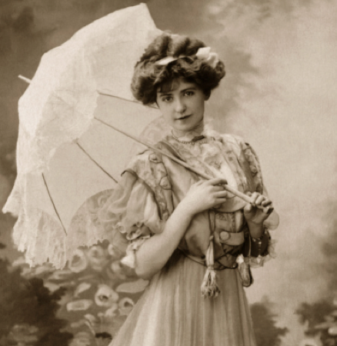
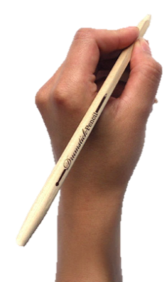
TITLE: How did WWI change women’s lives?
Starter
What did women do before 1914?

Slide 2
TITLE: How did WWI change women’s lives?
Learning Objectives
Level 4
To describe what roles women undertook in WWI
Level 5
To explain the advantages and disadvantages of women in WWI
Level 6/7
To evaluate why sources may have different interpretations about women in WWI

Slide 3
TASK
What does this poem tell us about attitudes towards women in Victorian Britain?
“Man for the field and woman for the hearth: Man for the sword and for the needle she: Man with the head and woman with the heart: Man to command and woman to obey;
All else confusion”
The Princess by Alfred Tennyson (1847)
Notes:
They could explore the idea that most Victorians believed that a woman’s place was in the home, looking after the household, husband and children. A popular phrase described the ideal role for the Victorian women as the ‘angels in the house’,

Slide 4
What does this suggest about how women were thought of before the war?
Notes:
http://www.youtube.com/watch?v=2Yujj4gkvRE&safe=active

Slide 5
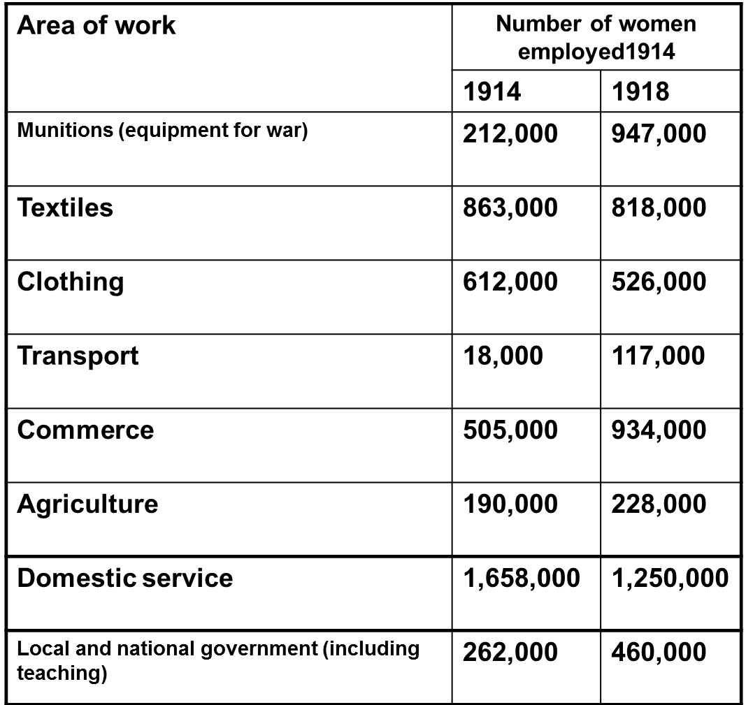
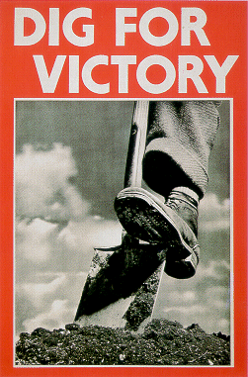
TASK
What were the largest areas of employment for women in 1914? How does this compare in 1918?
Notes:
Write down changes between 1911/1918

Slide 6
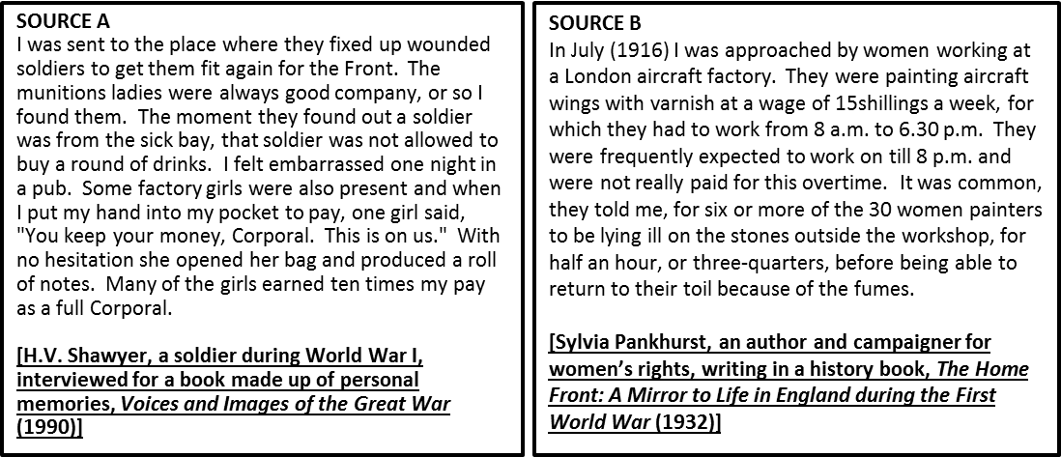
TASK
Summarise the two sources 2 sentences
What are the similarities between the sources?
What are the difference between the source?
Which source is most useful to a historian studying the role of women in WWI? (provenance)

Slide 7
TITLE: How did WWI change women’s lives?
Learning Objectives
Level 4
To describe what roles women undertook in WWI
Level 5
To explain the advantages and disadvantages of women in WWI
Level 6/7
To evaluate why sources may have different interpretations about women in WWI

Slide 8
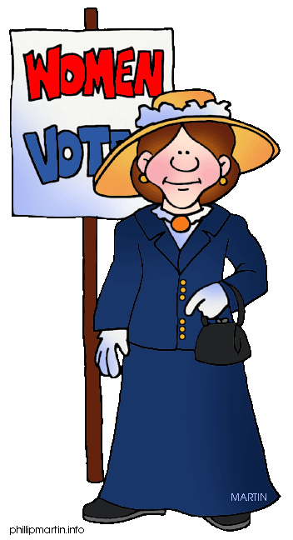
Plenary
Make a picket sign for why women should have the right to vote because of WWI
We worked in the factories,
We want victory!!

