Slide 1
Starter: Recap
TITLE: What were the trenches?
Notes:
http://www.youtube.com/watch?v=kfxrTD-kPps

Slide 2
TITLE: What were the trenches?
Learning Objectives
Remember you should have written the title and date and underlined them both in your book by now!
Level 4
All: describe the parts of a soldiers equipment and the parts of the trenches
Level 5
Most: explain the daily routine of the trenches with the use of a source
Level 6
Some: can analyse the provenance of a source to learn about the time spent in the trenches

Slide 3
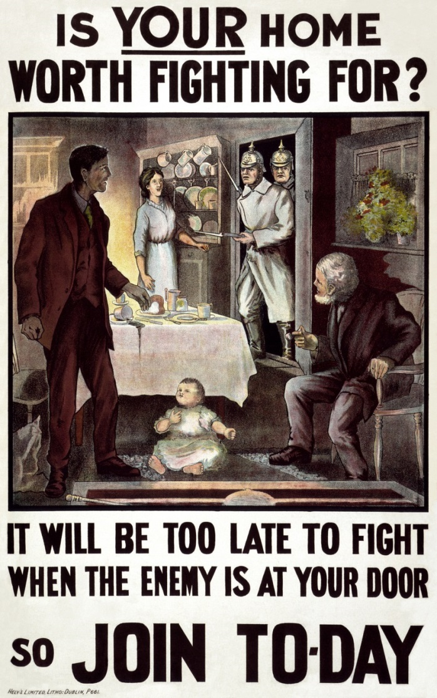
Homework: Reminder
Notes:
Remind students, re-write in planner if necessary, Make aware end of Year Trophy- encourage creation of model trench please!!

Slide 4
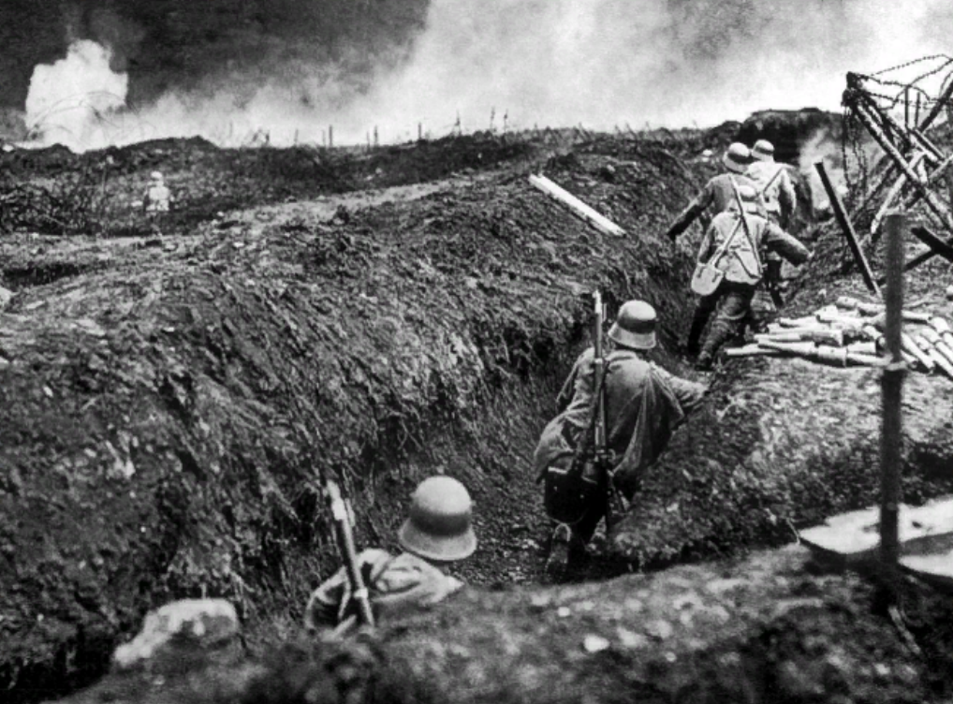
Key Term
TRENCH (TRENCHES)
A long, narrow ditch that was dug to protect soldiers in war

Slide 5
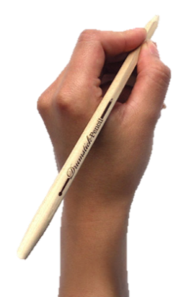
How did the trenches start?
As no one expected the war to last as long as it did, the first trenches were hurriedly made.
They were holes dug by soldiers to protect themselves from the enemy.
With modern weapons, even a shallow hole could sufficiently protect soldiers from the enemy.
But eventually the war became a stalemate and the trenches became ‘home’ for many soldiers

Slide 6
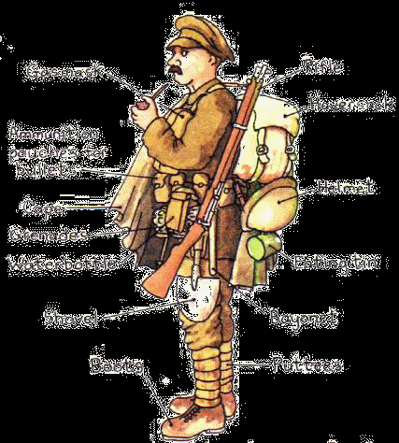
A Soldier’s Equipment
How could this equipment help / hinder the soldiers?

Slide 7
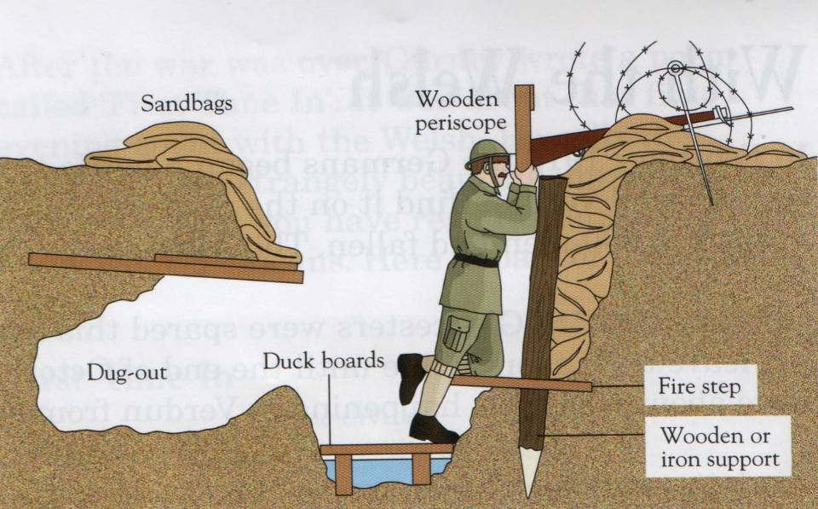
The Trenches
What was the purpose of the different parts of the trench?
To absorb bullets
Barbed Wire
Hinder enemy attack
Keep cover, sleeping
Steady ground to focus fire
Keep the soldiers out of water
Stop the ground from slipping
Notes:
Label parts of the diagram- Print for students

Slide 9
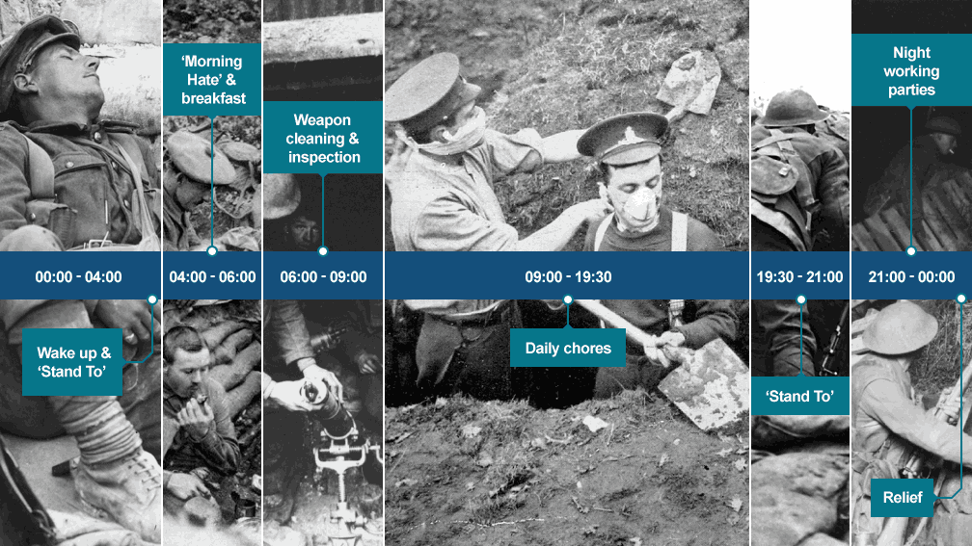
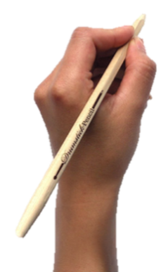
A day in the life…
What was daily life like??
‘Stand to’ was when they were ordered to climb up on the fire step to guard against a dawn raid by the enemy, bayonets fixed. the daily ritual often termed the 'morning hate'
Refilling of sandbags, the repair of the duckboards and the draining of trenches following heavy rainfall Others would be assigned to the preparation of toilet buckets.
Ritual repeated, in case of ‘dusk’ attacks
Notes:
Can just discuss

Slide 10
How much time in the trenches?
Notes:
http://www.youtube.com/watch?v=SMU582aqztk

Slide 11
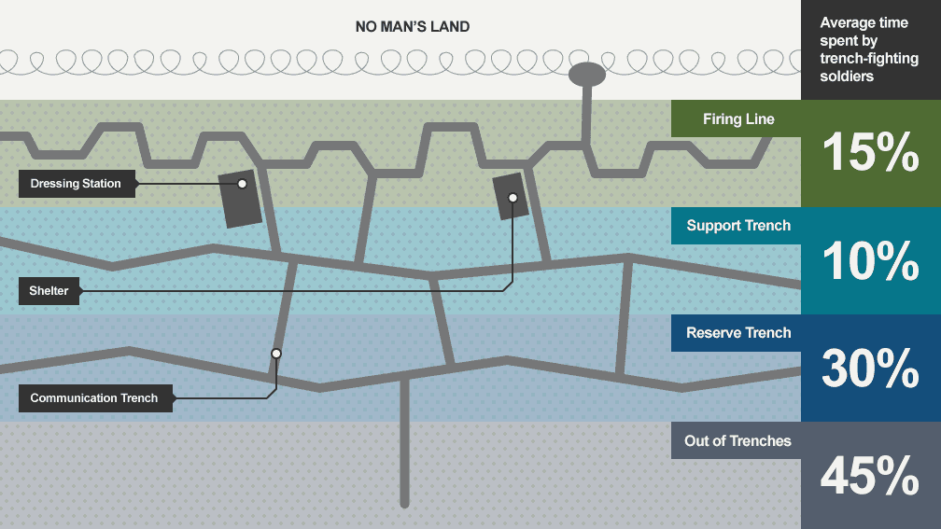
How often were soldiers in the firing line?

Slide 12
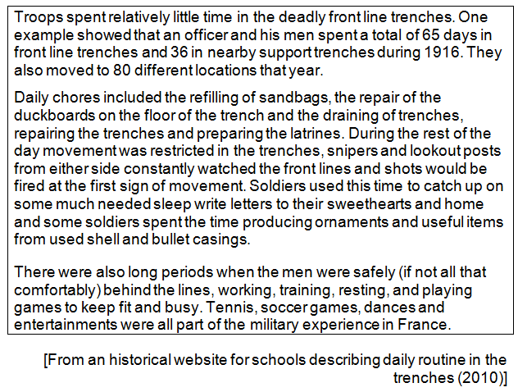
How much time in the trenches?
How useful and reliable is this source in explaining how much time was spent in the trenches?
What information does the source provide about conditions in the trenches?
Who was the author/maker? Why does that matter?
When was the source written?
Why was it written?
Is there any doubt over the author/is she trustworthy?
Notes:
Can print if required

Slide 13
TITLE: What were the trenches?
Learning Objectives
Remember you should have written the title and date and underlined them both in your book by now!
Level 4
All: describe the parts of a soldiers equipment and the parts of the trenches
Level 5
Most: explain the daily routine of the trenches with the use of a source
Level 6
Some: can analyse the provenance of a source to learn about the time spent in the trenches

Slide 14
Plenary
Pick your plenary question….
Level 4
All: describe the parts of a soldiers equipment and the parts of the trenches
Level 5
Most: explain the daily routine of the trenches with the use of a source
Level 6
Some: can analyse the provenance of a source to learn about the time spent in the trenches
Describe what ‘duckboards’ are for in the trenches
Why are sources useful for teaching historians about the trenches?
Why does who has written a source matter? Give an example to back up your point

Slide 15
