Slide 1
Persuasive Writing
‘Write a speech persuading Primary 7 pupils to come to Edmund Rice College

Slide 2
Making progress by:
Understanding what I need to do to write a speech;
Identifying and explaining the effect of persuasive devices;
Creating a paragraph in pairs about using mobile phones in school.

Slide 4
Have a go at matching up the techniques…
Challenge: No.9 isn’t there, but can you work out what it might be?
Notes:
1) Short sentence 2) rhetorical question 3) emotive language 4) dismissing the counter argument 5) humour 6) quote from an expert 7) statistic 8) triples 9) short sentence to get the point across.

Slide 5
Notes:
Cut up and use as a matching activity – I get the students to explain their effect once we’ve checked they’ve matched them correctly.

Slide 6
Explain:
Is the speech on mobile phones in school effective?
What is your opinion on the use of phones in school?
Do you agree with this speech, why or why not?
Task:
Imagine you are writing a speech in response to the one we have just looked at.
Can you persuasively write a paragraph – in pairs – arguing why students should be allowed mobile phones in school?
You must have at least 8 sentences.
You must have 2 persuasive devices in your paragraph (of your choice!).

Slide 7
Making progress by:
Recalling the persuasive techniques from last lesson and giving an example;
Discussing my opinions with my classmates about GCA;
Producing a paragraph, in a group to create a whole class speech.

Slide 8
Create a spider diagram with all the fantastic things about ERC!
A couple to start you off:
Super staff (!)
Magical English department
Great facilities

Slide 9
Group
Task:
Group Work Rules!
Don’t talk over each other
Share your ideas cooperatively
Assign your roles (vocabulary hunter, writer, editor)
Topics to be covered (and helpful hints to get you started):
Awesome facilities – what sets us apart from other schools? Why?
Lots of subject choice – what different subjects are you able to do at this school, which are your favourites and why?
Sporting achievements – what teams have we got, what trophies have we won?
Creative Arts department – What can you do, why is it better than most?
Results and statistics – why are we great? What does our Headteacher think of our results?
School Trips – what do you get to experience and where can you go?
Food/Canteen – what do we feed you, why is it good, what type of healthy eating projects do we run?
School Council – what do your representatives do for you, what kind of things do they give the students a voice about?
Each group will be given one of the following areas to write a positively, persuasive paragraph about ERC.
You must include 2 persuasive techniques and use a thesaurus to access some brilliant vocabulary.

Slide 10
Example:
I bet you thought you enjoyed your English lessons at primary school? You haven’t seen anything yet! The teachers here at ERC are fabulous the classrooms are vibrant - full of useful key words and terms, and the topics we cover can be really exciting.
So far this year, we’ve read nearly a whole novel, completed units and we’re not even at Easter yet.
Of course, like any school, there are assessments to complete – but we barely notice we’re doing them! Who wouldn’t want teachers like that? You’ll have to choose to attend this school – you’ll be missing out otherwise!
What techniques can you identify?
Are they effective?
Why/why not?

Slide 11
Let’s put our speech together!
How it works…
Nominate a reader in your group.
I’ll read the introduction, each group will then read their paragraph.
I’ll read the conclusion.
Listen carefully…
Fill in your evaluation worksheet giving each group a WWW and WTI.
Were they persuasive? Why/why not?
What persuasive techniques did they use?
Was their vocabulary ambitious?
Did it have a lively tone?
What would make their paragraph better?

Slide 12
Evaluation Sheet
Group/Topic | What Went Well | What to improve
Notes:
Print out for pupils – they will then have a bank of EBI’s to remind them when they write their own speech

Slide 13
An Introduction
Hello there, Primary 7. Welcome to our main hall here at Edmund Rice College! I bet you’re all wondering why you are here? Well, we love our school, we want to tell you about it so that you can come here and love it too!

Slide 14
A Conclusion
Well, there you have it. Edmund Rice College will help you reach your potential with our fantastic teachers, brilliant facilities and excellent extra-curricular timetable. There is something for everyone. Why would you want to go anywhere else? We’ll see you in September!

Slide 15
Plenary
What do I need to do to write an excellent speech?
Notes:
Print out or let students annotate on the IWB

Slide 16
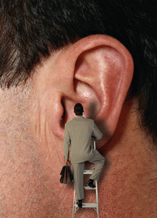
Making progress by:
Recalling the persuasive techniques from previous lessons;
Apply knowledge acquired in previous lesson;
Plan own speech persuading P7 pupils to come to ERC.

Slide 17
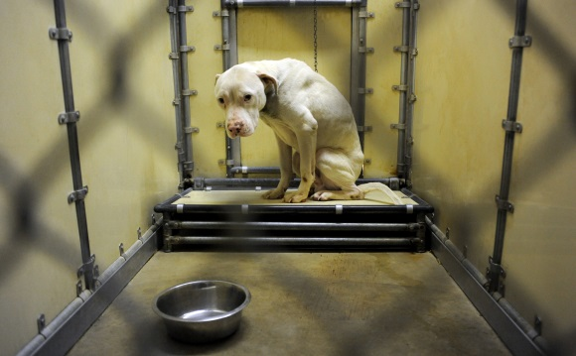
Starter
Give examples of the following persuasive techniques on the topic of Animal Cruelty:
Rhetorical question;
Rule of Three;
A fact;
A statistic;
Emotive Language and
An opinion.
If you are feeling super give an example of an anecdote.

Slide 18
‘Write a speech persuading Year 7 pupils to come to Edmund Rice College’
You are now going to begin planning your own persuasive speech.
You need an introduction, three main paragraphs and a conclusion.
You could use some of our ideas from the class speech but try to come up with your own.
Remember, you are writing about why you think the school is fantastic and why younger pupils should choose ERC as their secondary school.

Slide 19
Look at the evaluation sheet…
Look at your own ideas on how to write an excellent speech…
To be brilliant I need to:
You need to write in a clear way – in complete sentences.
Use a lively tone – remember you are happy to be here!
Use clear paragraphs and connectives to link them together.
Use effective and appropriate vocabulary.
To use correct spellings! If you are unsure – get a dictionary!
Notes:
Can be marked for Writing Assessment AF1, 3, 7 & 8

Slide 20
Use the planning grid to structure
your ideas…

Slide 21
Homework
Using your planning sheet – write up your introduction, and first two points into proper paragraphs.
Remember:
Full sentences, capital letters and full stops
Make sure your work is clear and readable!
We will peer mark these at the start of next lesson.

Slide 22
Making progress by:
Using planning sheet to write up my points into paragraphs;
Knowing and understanding the Speaking and Listening criteria and how to achieve my target level;
Practise delivering my speech with a partner.

Slide 23
Starter
Homework check!
Locate your homework – swap your exercise book with a partner.
Read your partner’s work.
Have they written an introduction? Is it clear what they are talking about?
Are there paragraphs?
Are full sentences used, with punctuation in the correct places?
Have they attempted to use ambitious vocabulary?
Is it persuasive?
Very neatly, underneath their work, give your partner a WWW and two WTI comments so they know how to improve!

Slide 24
Completing the writing…
You now have 20 minutes to complete your speech.
You have your third point and conclusion to write.
Make sure you pay attention to your EBI comments – make the improvements now!

Slide 25
Speaking and Listening:
Talking to Others (AF1)
Level 5 | I can talk in a way that engages the attention and interest of listeners through variation (changing) of vocabulary and expression. I can use standard English to explain, explore or justify an idea in formal situations.
Level 4 | I can speak clearly and audibly to a group, in a range of contexts, varying (changing) the formality of language in speech to suit different circumstances and engage the interest of the listeners. I can use some of the features of standard English vocabulary and grammar appropriately.
Level 3 | I can speak to a group, sometimes varying (changing) the formality of language. At times, I can use some of the features of standard English vocabulary and grammar (straightforward and appropriate language).

Slide 26
Work on that persuasive delivery…
It is time for you now to pair up with a classmate.
You are going to listen to each other delivering your speech, then you are going to give some positive criticism about the delivery of their speech.
What could they do better? Use the criteria below to help you give feedback…
Level 5 | I can talk in a way that engages the attention and interest of listeners through variation (changing) of vocabulary and expression. I can use standard English to explain, explore or justify an idea in formal situations.
Level 4 | I can speak clearly and audibly to a group, in a range of contexts, varying (changing) the formality of language in speech to suit different circumstances and engage the interest of the listeners. I can use some of the features of standard English vocabulary and grammar appropriately.
Level 3 | I can speak to a group, sometimes varying (changing) the formality of language. At times, I can use some of the features of standard English vocabulary and grammar (straightforward and appropriate language).

Slide 27
Speaking and Listening Evaluation
In your assessment book write the following:
Speaking and Listening – Talking to Others
Leave a space for your own self evaluation ( WWW and WTI)

