Slide 1
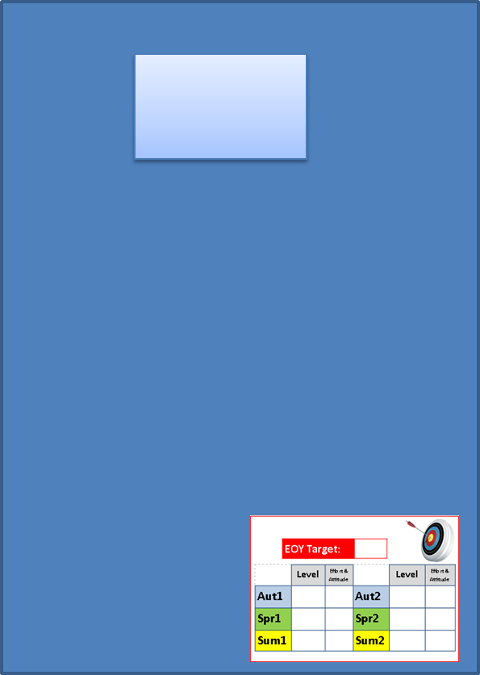
Starter
You have your assessment today! Spend 10 minutes revising what you have learnt so far…
How do I know how useful a source is?
What is an alliance?
Which countries were with which?
What is the arms race?
Who is Gavrilo Princip?
Why did Germany want an Empire?
What was the problem between Austria-Hungry and Serbia/Bosnia?
What happened in June 1914?
What were the causes of WWI?
What are the features of a trench?
What is the provenance of a source?
What equipment did a soldier carry?
What is a conscientious objector?
What is conscription?
What is propaganda?

Slide 2
Learning Objectives
Level 3
All: Will be able to recall facts about WWI.
Level 4
Most: Will be able to describe and explain key terms and ideas.
Level 5
Some: Will be able to use sources and their own knowledge to explain different ideas.

Slide 3
Year 8 Assessment
Have your reading book out before you start.
That way when you are sure you have finished you can read quietly so you don’t distract anyone else!

Slide 4
Year 8 Assessment
You will be given 35mins to complete the assessment. Take time to read through the sources carefully before you start to answer the questions.
Notes:
Can alter time depending on class ability- if some students allowed extra time, give whole class that extra time

