Slide 1
The weapons sheets have already been printed and laminated, in the HUMS office

Slide 2
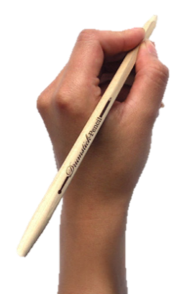
TITLE: How effective were the new weapons used in WWI?
Starter
What are some of the main weapons used in war in the last 20 years?

Slide 3
TITLE: How effective were the new weapons used in WWI?
Learning Objectives
Level 4
To describe some of the weapons used during the war
Level 5
To explain why a range of weapons were used during the war
Level 6/7
To explain why a range of weapons were used during the war

Slide 4
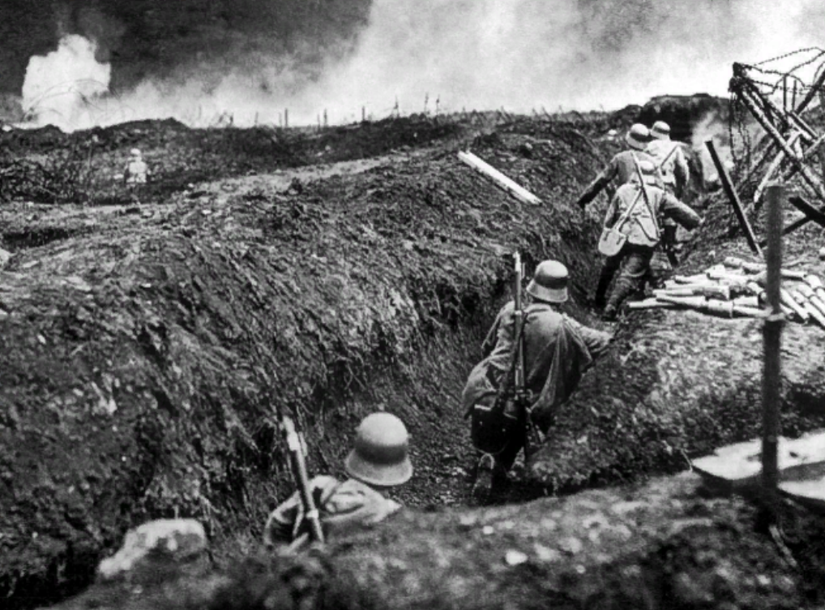
Key Term
ARTILERY
Guns and weapons that fire large bullets, or shells, over long distances.
DEFENCE/DEFEND
To protect oneself from the enemy

Slide 5
Training in WWI
Write down all the different training methods that you notice.
From 3mins
Notes:
http://www.youtube.com/watch?v=Mwr2eCzXmX8&feature=related&safe=active FROM 3MINS No need to watch all

Slide 6
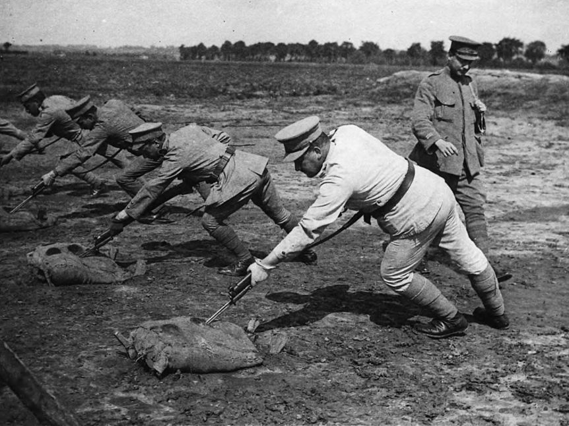
Training in WWI
How were the men being treated?
Do you think the officer training them was using the right tactics?
Do you think the army would train people like that today?
Notes:
Take student feedback, should have taken notes during video

Slide 7
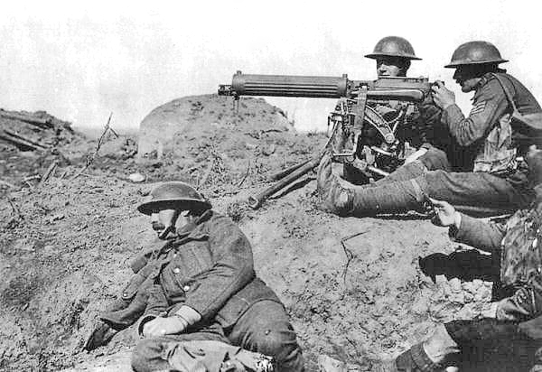
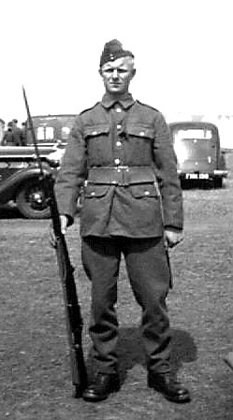
Weapons in WWI
During the 19th Century there had been great advances in technology, and this now meant that the weapons that the soldiers would use had got better as well.
How do you think new technology was going to:
Benefit the soldiers
Be a problem for the soldiers?
Lets read about some of the weapons that were used…
Notes:
Laminated worksheets in office

Slide 8
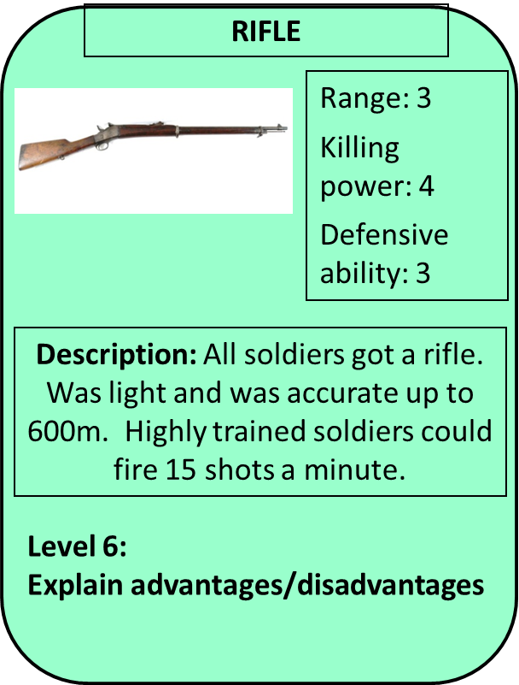
WEAPONS
You are going to design 4 top trumps cards using the information to help you.
ADVICE: Pick your 4 weapons first, so your ranks are relative
Range: how far could fire?
Killing power: How many people could it kill at one time?
Defensive ability: How well could you protect yourself?
Rank each weapon for each category on a scale of 1-5
1=low
3=medium
5=high
Notes:
Can differentiate the cards quite easily- can print and cut out for students if you wish!

Slide 9
WEAPONS
Peer assess your partners top trumps cards.
Tell them a ‘Strength’ and ‘Improvement’ such as:
you have described each weapon well
have designed your cards well.
Your description should include more statistics
Notes:
Once completed can play if time

Slide 10
TITLE: How effective were the new weapons used in WWI?
Learning Objectives
Level 4
To describe some of the weapons used during the war
Level 5
To explain why a range of weapons were used during the war
Level 6/7
To explain why a range of weapons were used during the war

Slide 11
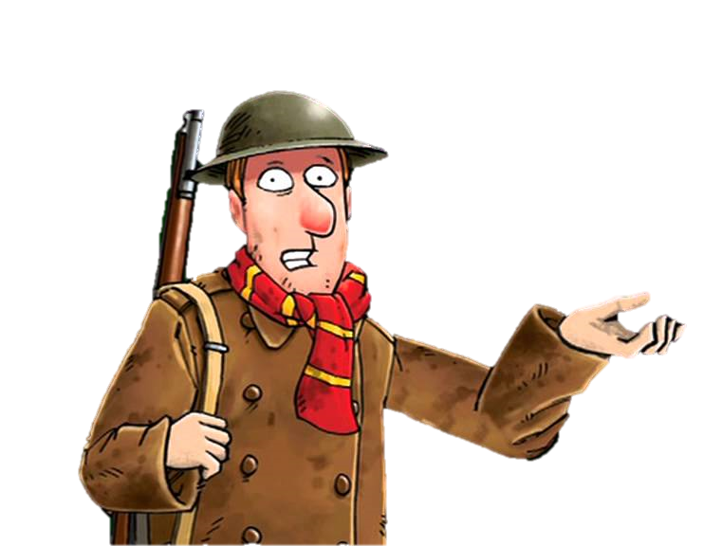
Plenary
What weapon would you most like with you in the trenches and why?

